Slide 1
SQL Project
Prepared By: Analyst Abhishek
LinkedIn
Portfolio

Slide 2
LIBRARY MANAGEMENT SYSTEM

Slide 3

Objective:
The objective of this Library Management System project is to create a
comprehensive and well-structured database that efficiently manages all key
operations within a library setting. This system is designed to organize and
centralize data on branches, employees, members, and library resources, allowing
for seamless data management and streamlined workflows. By automating routine
tasks such as tracking book availability, managing membership records, and
handling employee information, the system aims to reduce manual effort and
enhance operational efficiency. Additionally, the system provides quick access to
essential information, supporting accurate reporting and informed decision-making related to resource allocation, member engagement, and overall library
performance. This database solution ultimately serves to improve the library’s
ability to deliver timely services, optimize resource utilization, and maintain a high standard of data accuracy and accessibility.

Slide 4
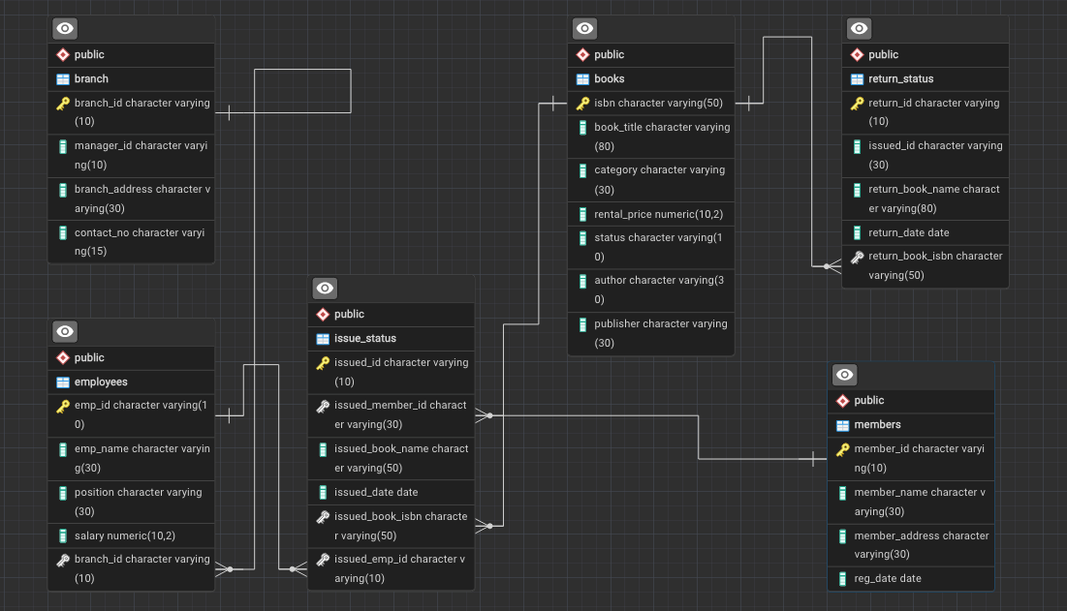

Schema

Slide 5

Tasks:
Task-1. Create a new book record-- "978-1-60129-456-2", "To kill a Mockingbird", "Classic", 6.00, "yes", "Harper Lee", "J.B. Lippincott & Co.")
Task-2. Update an Existing Member's Address where C=103 from 798 Oak St to 125 Oak St.
Task 3: Delete a Record from the Issued Status Table -- Objective: Delete the record with issued_id = 'IS121' from the issued_status table.
Task 4: Retrieve All Books Issued by a Specific Employee -- Objective: Select all books issued by the employee with emp_id = 'E101’.
Task 5: List Members Who Have Issued More Than One Book -- Objective: Use GROUP BY to find members who have issued more than one book.
Task 6: Create Summary Tables: Used CTAS to generate new tables based on query results - each book and total book_issued_cnt
Task 7. Retrieve All Books in a Specific Category:
Task 8: Find Total Rental Income by Category:
Task-9: List Members Who Registered in the Last 180 Days
Task-10: List Employees with Their Branch Manager's Name and their branch details
Task 11. Create a Table of Books with Rental Price Above a Certain Threshold

Slide 6
Tasks:
Task 12: Retrieve the List of Books Not Yet Returned
Task 13: Identify Members with Overdue Books. Write a query to identify members who have overdue books (assume a 30-day return period). Display the member's_id, member's name, book title, issue date, and days overdue.
Task 14: Update Book Status on Return. Write a query to update the status of books in the books table to "Yes" when they are returned (based on entries in the return_status table).
Task 15: Branch Performance Report. Create a query that generates a performance report for each branch, showing the number of books issued, the number of books returned, and the total revenue generated from book rentals.
Task16: CTAS: Create a Table of Active Members. Use the CREATE TABLE AS (CTAS) statement to create a new table active_members containing members who have issued at least one book in the last 2 months.
Task 17: Find Employees with the Most Book Issues Processed. Write a query to find the top 3 employees who have processed the most book issues. Display the employee name, number of books processed, and their branch.

Slide 7
Tasks:
Task 18: Identify Members Issuing High-Risk Books. Write a query to identify members who have issued books more than twice with the status "damaged" in the books table. Display the member name, book title, and the number of times they've issued damaged books.
Task 19: Stored Procedure Objective: Create a stored procedure to manage the status of books in a library system. Description: Write a stored procedure that updates the status of a book in the library based on its issuance. The procedure should function as follows: The stored procedure should take the book_id as an input parameter. The procedure should first check if the book is available (status = 'yes'). If the book is available, it should be issued, and the status in the books table should be updated to 'no'. If the book is not available (status = 'no'), the procedure should return an error message indicating that the book is currently not available.
Task 20: Create Table As Select (CTAS) Objective: Create a CTAS (Create Table As Select) query to identify overdue books and calculate fines. Description: Write a CTAS query to create a new table that lists each member and the books they have issued but not returned within 30 days. The table should include: The number of overdue books. The total fines, with each day's fine calculated at $0.50. The number of books issued by each member. The resulting table should show: Member ID Number of overdue books Total fines

Slide 8
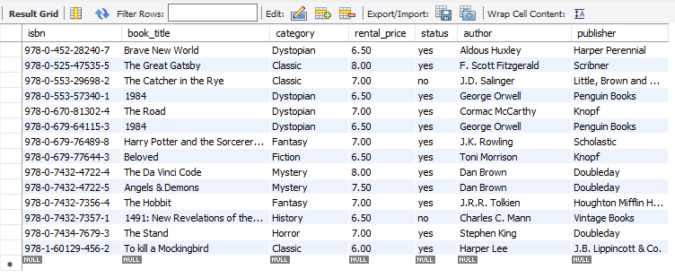
Task-1. Create a new book record-- "978-1-60129-456-2", "To kill a Mockingbird", "Classic", 6.00, "yes", "Harper Lee", "J.B. Lippincott & Co.")

Slide 9
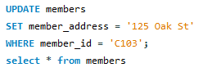
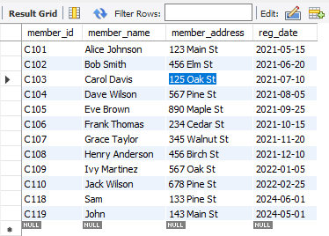
Task-2. Update an Existing Member's Address where C=103 from 798 Oak St to 125 Oak St.

Slide 10
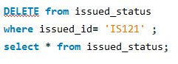
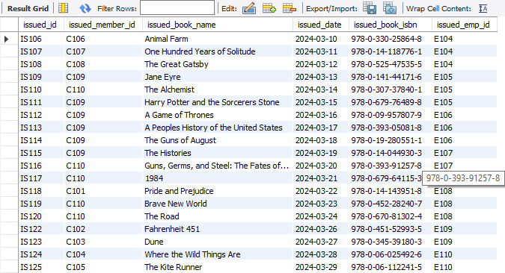
Task 3: Delete a Record from the Issued Status Table -- Objective: Delete the record with issued_id = 'IS121' from the issued_status table.

Slide 11
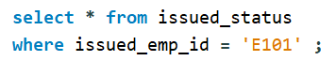
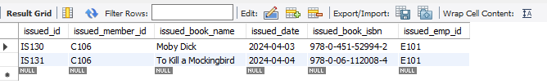
Task 4: Retrieve All Books Issued by a Specific Employee -- Objective: Select all books issued by the employee with emp_id = 'E101’.

Slide 12
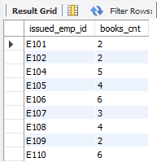
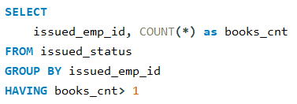
Task 5: List Members Who Have Issued More Than One Book.
- Objective: Use GROUP BY to find members who have issued more than one book.

Slide 13
Tasks
01 Write here a title
02 Write here a title
03 Write here a title
04 Write here a title
05 Write here a title

Slide 14
Your great subtitle in this line
Replaced with your own text

Slide 15
Your great subtitle in this line
Replaced with your own text

Slide 16
THANK YOU

